Slide 1


M
AJOR GIFTS
Presented by:
Tammy Pallot
Notes:
Because parts of this presentation are automated, an “*” in the notes indicates the need to click the mouse.
All too often we hear stories where we learn that a faithful parishioner has given a major gift to a library or a college. The parishioner is more invested in their church emotionally, so we are confused about why they gave such a significant gift to a library instead of their church?
The reality is that “we” the church, never bothered to ask boldly for the gift whereas the library did – and they asked with a plan
and they asked for something they knew the person was passionate about
and they sent the right people to ask.
They had a plan. The plan wasn’t manipulative…it was just a well-organized request to which the person could say “yes” or “no”.
So that’s why we’re focusing today on Major Gifts.
Before we begin, we need to be clear about what we are talking about when we say “major gift”? A major gift will generally fall into one of three categories – a capital campaign, a special project, or a planned gift (i.e., in their will). Although you can find some sources who will define a major gift with a dollar value, I am not. For our purposes, a major gift is any significant financial gift above the norm for your culture. And, I say that because what would qualify as a major gift for St. Francis in Macon will likely look different than a major gift for Trinity Wall Street. But – just for the record – if anyone would like to give St. Francis a Trinity Wall Street sized major gift, we would be more than happy to accept it. *

Slide 2
M
AJOR GIFTS
Presented by:
Tammy Pallot
Notes:
I hope this information today will

Slide 3
M
Notes:
help you to get the ball rolling

Slide 4



M
Notes:
… so you can launch a systematic approach to

Slide 5

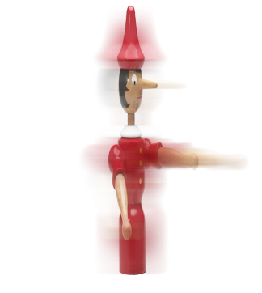
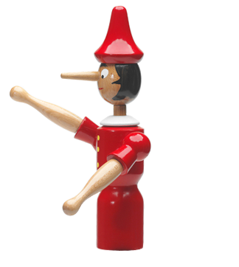
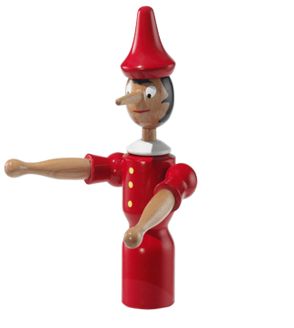

M
M
Notes:
… identifying, cultivating, and stewarding major gifts

Slide 6
M
Notes:
….as a way to increase your financial resources

Slide 7
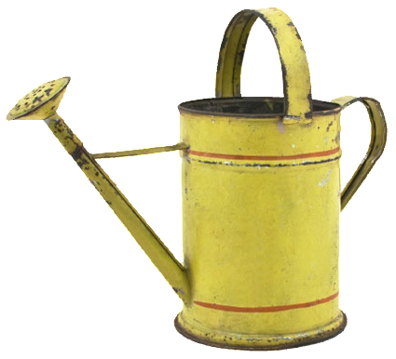
M
Notes:
…and grow your capacity

Slide 8














Notes:
… for ministry and mission. *

Slide 9




8
STEPS
Notes:
We’ve put together …

Slide 10
8
STEPS
FOR
WORLD
CULTIVATING
MAJOR GIFTS
CHANGING
Notes:
…8 simple steps for cultivating world-changing major gifts.

Slide 11

IDENTIFY
YOUR
PROSPECTS
NOT
SUSPECTS
Notes:
The first step is: Identify your prospects, not suspects. *

Slide 12
PROSPECTS
LINKAGE
Linked to the parish by real attendance and by personal involvement
ABILITY
The person has the ability to make a large gift without in any way jeopardizing their immediate well-being
INTEREST
A person who has caught sight of a vision and is so inspired, personally involved, and invested in its success that they desire to make a major gift in order to make a vision into a reality
Notes:
Prospects have these three characterisitics:
Linkage – They are linked to the parish by real attendance and by personal involvement.
* Ability – The person has the ability to make a large gift without in any way jeopardizing their immediate well-being.
* Interest – A person who has caught sight of a vision and is so inspired, personally involved, and invested in its success that they want to make a major gift in order to make a vision into a reality.
A SUSPECT, on the other hand, is someone who may have some linkage and may have ability but has not been personally engaged. In other words, just having money does not make a person a prospect.
So, where do we find Prospects? *

Slide 13

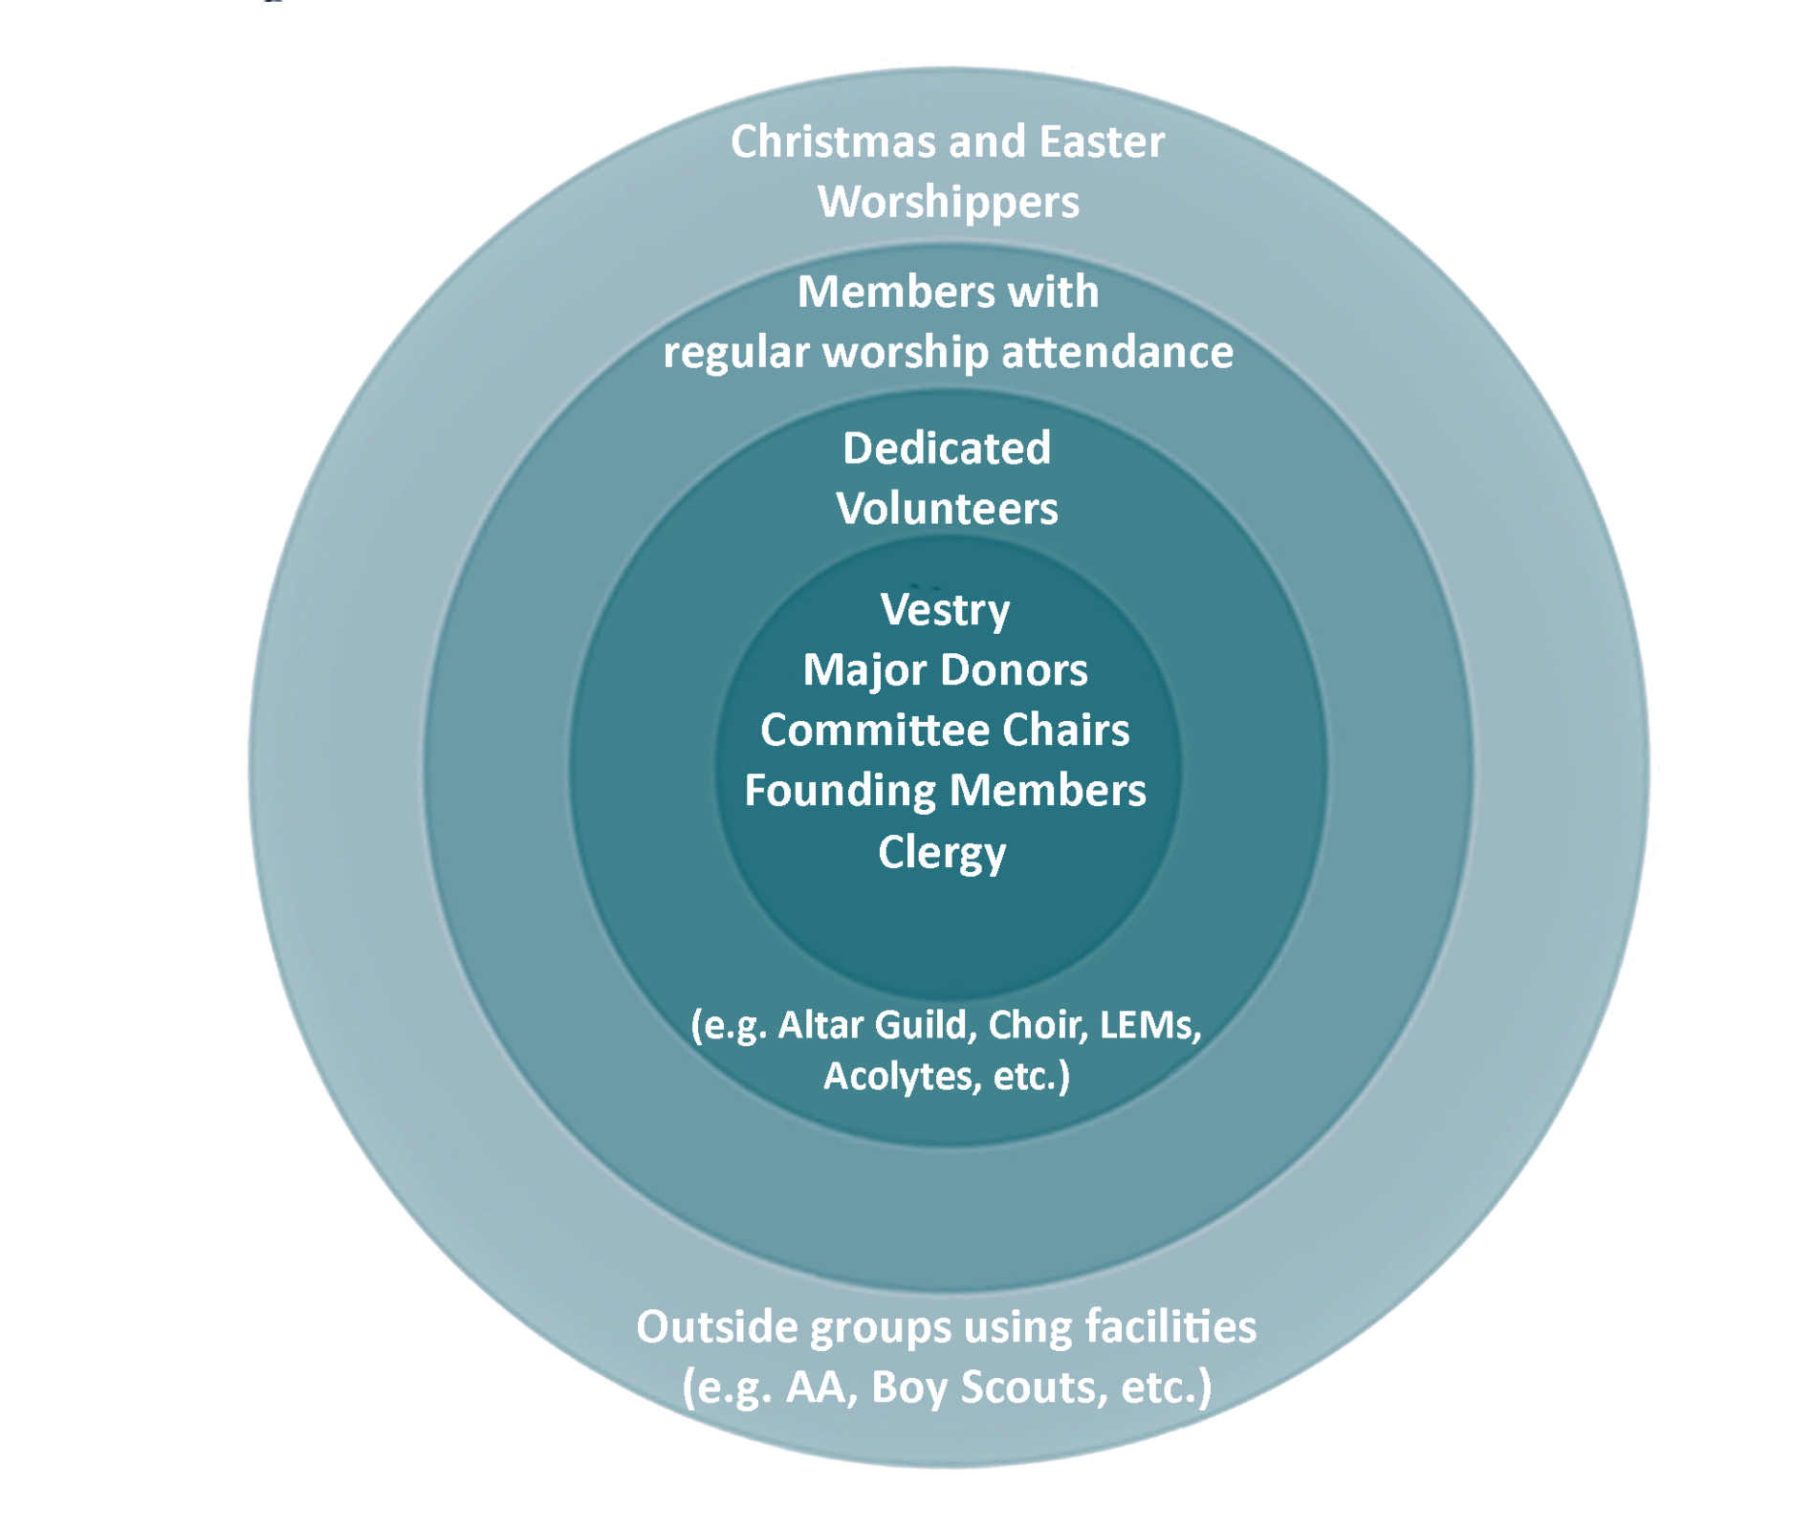










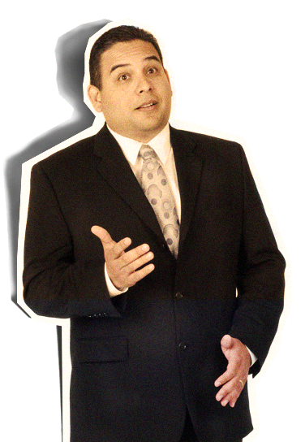
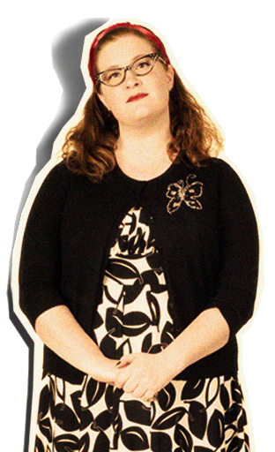


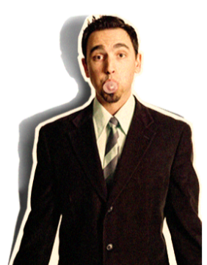
The Constituency Model
Notes:
Using The Constituency Model, we start at the center and work out. Start with those who are most involved with your parish – vestry, current major donors, committee chairs. Then move out to members of your ministry teams….then members with regular worship attendance, then outside groups who use your facility, and finally – friends of members, former members, other Episcopalians. The further away from the center you move, the less likely a person is to be a viable prospect because – remember, one of the characteristics of a prospect is someone who is actively engaged. *

Slide 14



2
QUALIFY
PROSPECT’S
CAPACITY
IN ADDITION
TO
THEIR
INTEREST
Notes:
Step 2 – Qualify your potential prospects capacity in addition to their interest.
So you have your list of potential prospects. I may LOVE your church. I may serve on every ministry team you have and be there every time the doors open, BUT my income does not give me the capacity to be a major donor.
So how do you qualify someone’s financial capacity? *

Slide 15


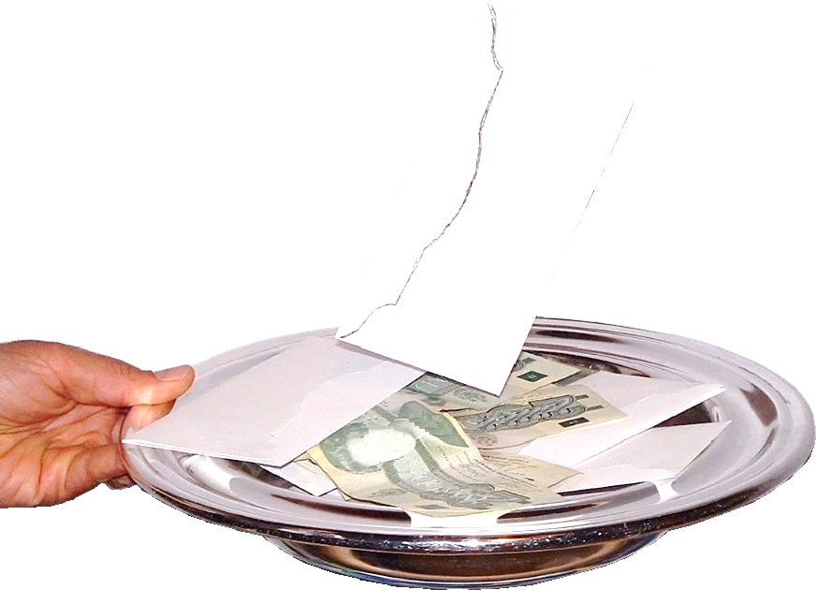



Notes:
There are quite a few fee based databases available such as Wealth Engine and Donor Search. These services provide information such as net worth, income, assets, real estate, charitable giving, and more.
There are quite a few free databases available too –
* Open Secrets.org – You can enter a donor name and see any money given to federal candidates, political action committees, and party committees.
* The Chronicle of Philanthropy has a lot of valuable information for non-profits, including a “Big Charitable Gifts” database for donations over $1 million. You can search by donor, recipient, cause, or state. The amount of money recorded on this database is breath taking.
* The Federal Election Commission has a searchable database for all campaign contributions. You can enter your city and see every person who has given anything from $1 up.
All of these databases are helpful, * but you also can gain some insight about your prospects capacity based on their current giving to the church.
Thus far, we have identified a list of prospects and qualified their financial capacity for being a major donor. *

Slide 16

3
DEVELOP A
STRATEGY
AND
TIMETABLE
Notes:
The 3rd step is to Develop a Strategy and Timetable

Slide 17
BLAH
BLAH
BLAH
BLAH
BLAH
BLAH
BLAH
Notes:
You need to develop a compelling case for support—or reason to give— because you want to educate your prospective donors and motivate them to contribute.
Several years ago a marketing consultant named Simon Sinek noticed a pattern. It turns out that all the great, inspiring leaders and organizations in the world all think, act, and communicate in the same exact way – and it is the complete opposite to everyone else. *

Slide 18
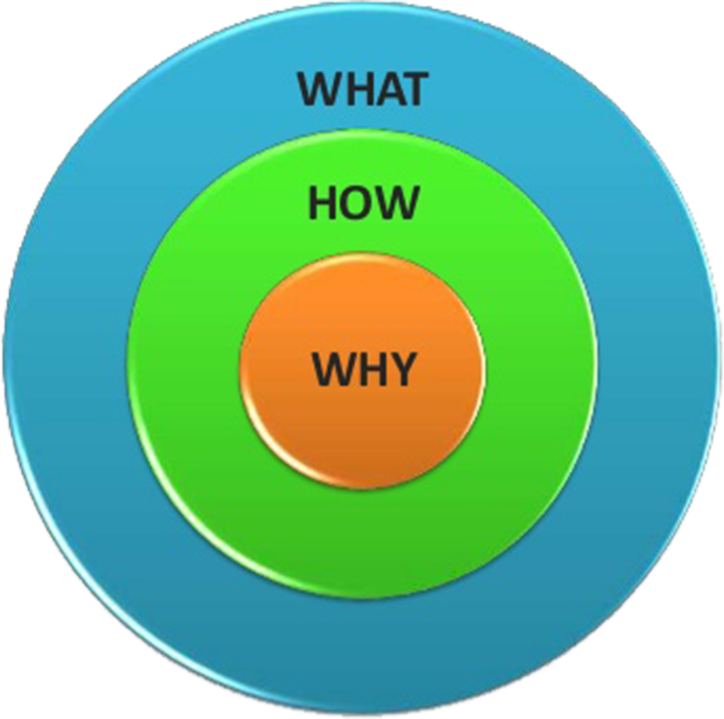

THE
GOLDEN
CIRCLE
Strong, Inspirational
Uninspiring
SIMON
SINEK
Notes:
He called it the golden circle – why, how, what. This idea explains why some leaders and organizations are able to inspire and others are not.
Every single person, every single organization on the planet knows what they do – 100%. Some know how they do it. But, very few people or organizations know why they do what they do. (And “why” is never “to make a profit.” That is a result.)
By why I mean “what’s your purpose”, what’s your cause, what’s your belief - Why does your organization exist? And, why should anyone care?
As a result, the way we think, the way we act, the way we communicate * is from the outside in – We go from the clearest thing to the fuzziest thing.
* But, the inspired leaders and the inspired organizations – regardless of their size, regardless of their industry – all think, act, and communicate from the inside out.
Let me give you an example – I’m going to use Apple because they are easy to understand and everyone gets it. *

Slide 19
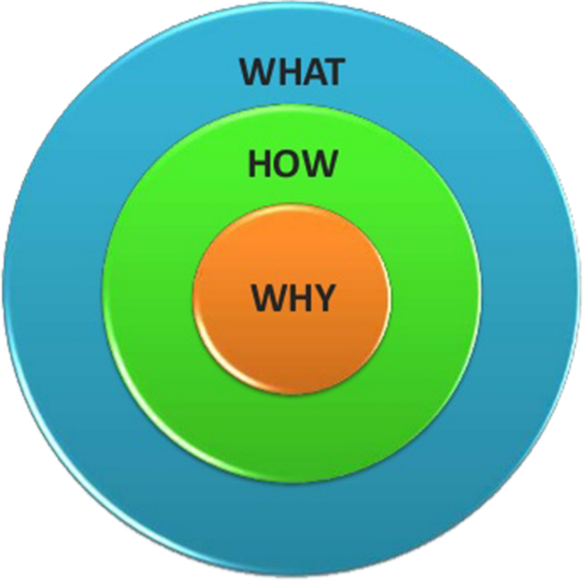

IF APPLE COMMUNICATED LIKE MOST COMPANIES:
We make great computers.
They are beautifully designed, simple to use, & user-friendly.
Want to buy one?
Inspirational
Uninspiring
HOW APPLE ACTUALLY COMMUNICATES:
In everything we do, we believe in challenging the status quo. We believe in thinking differently.
The way we challenge the status quo is by making our products beautifully designed, simple to use, & user-friendly.
And we happen to make great computers.
Want to buy one?
Notes:
If Apple communicated like most companies, they would say something like:
We make great computers.
They are beautifully designed, simple to use, & user-friendly.
Want to buy one?
Meh….
* But here’s how Apple ACTUALLY communicates. They say:
In everything we do, we believe in challenging the status quo. We believe in thinking differently.
* The way we challenge the status quo is by making our products beautifully designed, simple to use, & user-friendly.
* And we happen to make great computers.
* Want to buy one?
It’s totally different right? All I did was reverse the order of the information. What this shows us is that people don’t buy WHAT you do, they buy WHY you do it. Let me say that again: People don’t buy what you do, they buy why you do it. This explains why every person in this room is perfectly comfortable buying a computer from Apple – and why we are also perfectly comfortable buying something other than a computer from Apple – like a MP3 player or a phone. *

Slide 20

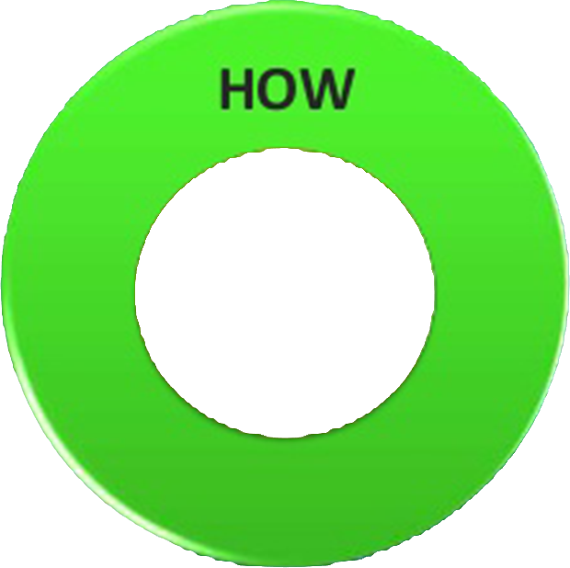

Strong, Inspirational
Notes:
Here’s what’s exciting about this model – all of this is based on the tenets of biology – the brain can be broken down into 3 major parts which correlate perfectly with the golden circle.
* Our newest brain, our neocortex, corresponds to the WHAT level – it is responsible for our rational and analytical thought and language.
* The middle two sections make up our limbic brain – which is responsible for all of our feelings – like trust and loyalty. It is also responsible for all human behavior – all decision making – but it has no capacity for language. In other words, when we communicate from the outside in, yes – people can understand tremendous amounts of complicated information like features and benefits and facts and figures – but it just doesn’t drive behavior.
* When we communicate from the inside out, we are talking directly to the part of the brain that controls behavior and then we allow people to rationalize it with the tangible things we say and do. This is where gut decisions come from.
You know how sometimes you can give someone a ton of information and they say, “I know what all the facts and figures say, but it just doesn’t FEEL right.” We use that expression – “it just doesn’t feel right” – because that part of the brain that controls decision making doesn’t control language, so the best we can muster up is “I don’t know….it just doesn’t feel right.”
Or sometimes we say “I’m leading with my heart” or “I’m leading with my soul.” I hate to break it to you, but those aren’t other body parts controlling your behavior. That’s all happening here in the limbic brain – the part of the brain that is controlling decision making, but not language.
So if you don’t know WHY you do what you do and people respond to WHY you do what you do, then how will you ever get anyone to “buy what you do” or donate money or – more importantly, be loyal and want to be a part of what it is you do? So, the goal is not to sell people what you have, but to sell to people who believe what you believe.
For example, if we were strictly talking about hiring, the goal would not be to just to hire people who need a job. The goal would be to hire people who believe what you believe. If you hire people just because they can do a job, they will work for you for your money. But if you hire people who believe what you believe, they will work for you with their blood, sweat, and tears. I think that is something that most of us have experienced at some point in our lives.
Once you have developed your why and how, the other part of this strategizing step is working out the logistics – the detailed information about exactly what you need, how much it is going to cost, and how long it is going to take. Then you strategize your “moves”. *

Slide 21

















4
CULTIVATE
HEALTHY
RELATIONSHIPS
Notes:
The 4th step is: Cultivation. Cultivate healthy relationships.
In the corporate world, this is referred to as “moves management”. I have to admit, the idea of “moves management” makes me feel like I need to shower. But – in reality, “moves management” is just a systematic approach to relationship building.
Which means…..this is not something you do TO the prospect. And it’s not something you do when the spirit moves you. It’s a deliberate, focused set of actions that all build on each other to create close relationship, a happy donor, and a generous major gift to your ministry.
You should have a minimum of 6 cultivation contacts (or moves) with the prospect before you ask for a major gift. *

Slide 22
Name | Cultivation 1 | Cultivation 2 | Cultivation 3 | Cultivation 4 | Cultivation 5 | Cultivation 6 | Ask | Follow-up
Smith, Joe | Dinner with Harry Walsh | Visit site of the new building | Lunch with Rector at Rectory | Meet with architects to review plans | Meet with donor of similar gift | Visit similar church which has new building | Walsh and Rector | Personal visit by Campaign Chair
Notes:
You should plan and keep track of your cultivation contacts (or moves). One easy way to do that is with a spreadsheet
You can easily create a spreadsheet with each prospects name and a list of planned contacts. These contacts are where you share your case for support with the prospect. If we are talking about a capital campaign – you might invite the person to come look at where the new building will be for one meeting. At another meeting, you could show them the architectural plans and ask for their input.
The important thing is that you are building a relationship and (hopefully) inspiring them to want to be a part of what you are doing.
I also want to point out that these cultivation contacts can and perhaps should be spread out between a team of up to 3 people*

Slide 23




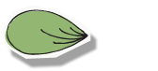





5
REQUEST
THE
GIFT
DECORATION
Notes:
Step 5: Request the Gift or “The Ask”
Where will the ask occur?
It should be Face-to-Face
Appropriate setting (McDonald’s is probably not the place to ask for a major gift.)
Who will be the “askers”?
Clergy
Friend or individual with a close connection *

Slide 24
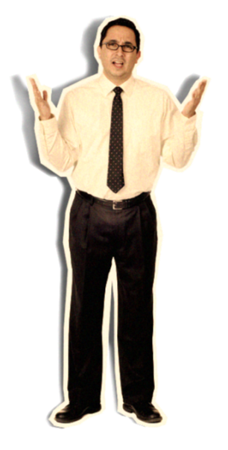
Notes:
But how do you actually ask? Even the thought of asking for a major gift can be anxiety producing, so here is a simple framework to help guide you through the process.

Slide 25




6 Minutes
5 Minutes
THE PRELIMINARY TO THE ASK
2 Minutes
THE ASK
A specific amount is asked for and silence follows. (2 minutes)
Conversation and Negotiation (3 minutes) – Imagine possible negative responses and how you would face them in conversation.
THE ENDING CONVERSATION
Restate the case summary.
Restate the “ask”.
Restate the benefits of the gift.
Establish the next step.
2 Minutes
Introduction (
Why are you here?
What is your common ground?
THE INTRODUCTION
Review the case.
If the donor gets bored, asks questions in which the donor states the case.
Ask if you have been understood.
Why are you here?
What is your common ground?
Notes:
The entire solicitation should only take about 15 minutes.
The introduction should last about 2 min and cover
Why are you here?
What is your common ground?
* Then, The preliminary to the ask – which should take about 6 min
Review the case.
If the donor gets bored, ask questions in which the donor states the case. (Because the donor should know the case as well as you do by now.)
Ask if you have been understood.
*The, “The Ask” – which lasts about 5 min
A specific amount is asked for (Remember - people aren’t offended when they are asked for too much, but they are offended if they are asked for too little! If you have asked for too much, the person being asked will simply make whatever gift they can.) So…. A specific amount is asked for and silence follows. This is the most awkward and most holy part of this process and it is often where people get anxious as they wait for people to think about the request. If horrible doubts begin to run through your mind – Ignore them! Just wait for the person being asked to speak first. Keep in mind that in the silence, the Holy Spirit is working and the person being asked is thinking and possibly praying. You don’t want to interrupt that.
This is followed by “Conversation and negotiation” for about 3 min – Make sure that before this meeting you have spent some time imagining possible negative responses and how you will respond to them.
*The ending conversation – This should take about 2 min
Restate the case summary.
Restate the “ask”
Restate the benefits of the gift – Your gift is going to enable….
Establish the next step. (When people decide to give a major gift, they rarely have the cash sitting beside them. The next step may be “I’ll get this check to the bookkeeper so we can get started” or “I’ll expect to hear from your stock broker in the next few days”) *

Slide 26



6
THEM
THE
ACKNOWLEDGEMENT
YOU
ARE
AND
FOLLOW-UP
Notes:
Step #6 - The Acknowledgement and Follow-up
How will you thank the donor?
Keep in mind the idea of “receipt v. thank you”. I think, as a general rule, we are pretty good about giving people receipts for their gifts, but we’re not so good about actually thanking people.
Some idesas for acknowledgement and Follow-up are:
Phone calls
Hand-written notes
If the donor is okay with their gift being made public - email or mail newsletters
Videos and photographs
Appreciation events
Annual reports *

Slide 27
7
STEWARDSHIP
Notes:
The 7th step is Stewardship. Be a good a steward of their gift.
If I gave you $10,000 to help the children in your orphanage and you didn’t spend any of the money on the kids, but instead you bought some really nice paintings for the front office, do you think I am ever going to give you money again? No.
We must make sure that we are being good stewards of the resources entrusted to us – AND we must communicate to the donor how their gifts are being used. “Thanks to your gift, we were able to take the children on a field trip out of town to the aquarium.” *

Slide 28
8
BEGINNING
AGAIN:
RENEWAL
NOT
SUSPECTS
Notes:
And the final step, #8, Renewal
Beginning again from the beginning…
When should you ask a donor to give again?
Hint: It depends! It is different for every donor, but you should be able to tell whether or not they are ready to be asked again during your cultivation contacts. And, if you have had your 6 cultivation contacts and you don’t think the prospect is ready to be asked, don’t do the ask just because it is the next block on your spreadsheet. Add as many contacts as necessary before you feel the donor is ready. *

Slide 29

PERSON
THE
RIGHT
PERSON
THE RIGHT PERSON
ASKING
THE
RIGHT
PERSON
ASKING THE RIGHT PERSON
AT
THE
RIGHT
TIME
AT THE RIGHT TIME
FOR
THE
RIGHT
AMOUNT
FOR THE RIGHT AMOUNT
FOR
THE
RIGHT
PROJECT
FOR THE RIGHT PROJECT
Notes:
So, really, all of this comes down to The 5 R’s:
The right person
Asking the right person
At the right time
For the right amount
For the right project
Our anxiety about asking for money for the mission of the church is something we need to heal. They say that the best way to get over a fear of horseback riding is to get onto a horse. The best way to get over the fear of asking for a gift – is to go ahead and ask for one! So, that’s what we are going to do. *

Slide 30
“Dr. George and Helen Pappas”
ACTIVITY INSTRUCTIONS
Divide into groups (4 people per group)
George Pappas
Helen Pappas
Solicitor
Observer
The Observer gets “The Hidden Agenda” envelope
ONLY George, Helen, and the Observer read “The Hidden Agenda” - THE SOLICITOR DOES NOT READ
Notes:
Let me tell you about Dr. George and Helen Pappas:
The Pappas’ live at 714 Regal Circle in an affluent suburb. Dr. George is an orthopedic surgeon who has been in practice for 16 years. Helen is a nurse. They met during residency. She does not presently work. They have four children, two of whom are now in college. Dr. Pappas has a reputation for working extremely hard and is only occasionally in church, busily making rounds and attending to his large and successful practice. He does make an effort to be involved in the civic affairs of the community - especially the Hellenic Medical Society, where he twice served as president. He donated the library to the small medical school in the city though it was not his alma mater.
Helen is active in Junior League and is a board member of the local symphony. She has also been very involved in the private school that her children attended, having served on the board of trustees there. She is very faithful in church attendance, assiduously bringing the children to Sunday School for many years. She served on the parish vestry for one term a number of years ago and presently serves as a volunteer in the parish with a ministry to aid the poor.
Their giving to the church has been regular - $5,000 toward the annual operating budget and occasional special gifts for specific appeals. When the interior of the church was newly appointed ten years ago, they contributed $25,000 toward the altar furnishings.
The parish is now in the quiet phase of a capital campaign to construct a new educational building. The cost of the project is $6 million. The campaign team feels that the Pappas’ should be asked to give $100,000. Dr. Pappas is known to be a savvy investor and there are rumors that he provided most of the start up money for a company that recently made its initial stock offering. The stock opened at 7 and three months later has risen to 22.
Now for your instructions. Please listen to ALL of the instructions before you start moving around. *
You are going to divide into groups of four – four people per group. Once you are in your groups, you need to decide who is going to be which role – George, Helen, Solicitor, and Observer.
Once you have assigned roles, * the observer is going to come up here and get the “Hidden Agenda” envelope. There is a green card in this envelope with information that ONLY the Pappas and the Observer can see. So – if you are the solicitor you do NOT get to see this information.
Are there any questions?
(After enough time for the activity to be completed…. * )
The information included in The Hidden Agenda envelope is below:
The Hidden Agenda
1. The Pappas’ always confer on their charitable giving, making a joint decision.
2. The Pappas’ own one million shares of stock in the company.
3. Their cost basis was $1 per share.
4. Restrictions on the stock will not allow the Pappas to give or sell any for one year following the initial public offering.
5. Both the symphony and Dr. Pappas’ alma mater have already initiated discussions with them concerning major gifts.
6. Dr. Pappas’ brother and nephew, both church members, were also early investors in the company, each owning 500,000 shares. Helen is keenly interested in the project, feeling that it is very important for children to have a good education in their faith. She knows the poor conditions of the present teaching environment. Dr. George and Helen do not want to feel that they are the only major donors.
7. The Pappas should assume a cooperative, open, receptive attitude in the role-play and exhibit a willingness to share information if the solicitor asks open but not intrusive questions.

Slide 31
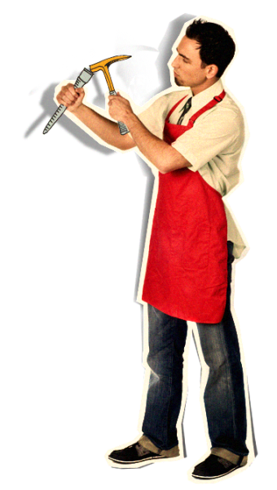
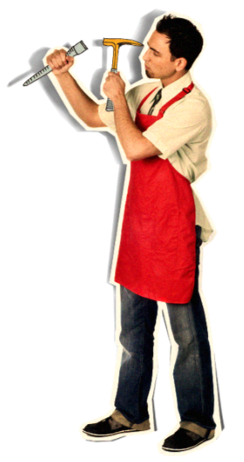
Notes:
Let’s spend some time breaking this activity down.

Slide 32




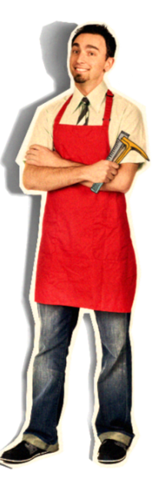

















































Notes:
How did it go?
What would you have done differently?”
What worked?
What didn’t work?’
Solicitors?
Pappas?
Observers?
What strategies should the solicitors have tried, but didn’t?
How much of the hidden agenda was revealed? How did the solicitors deal with the new information?
How many people said “no”? What would be good follow up actions that help the Pappas’ get
to a “yes” and/or honor their pledge?
What other opportunities were revealed? How should these be approached?
What did you notice about body language, eye contact, and facial expressions? *

Slide 33

Tammy Pallot
tammypallot@gmail.com
(478) 954-5441
Notes:
Although asking for a Major Gifts can feel awkward – and it is easy to talk yourself out of it – I hope you will remember that you are asking for a gift which will, in the giving of it, bless the giver, bless the receiver and honor God.
(Personal story about asking for a major gift and how it truly blessed the giver, the church and me personally.)
Thank you.

